Slide 1
Chapter 5 break Statement

Slide 2
break Statement
The break statement terminates the loop (for, while and do...while loop) immediately when it is encountered. Its syntax is:
break;
The break statement is almost always used with if...else statement inside the loop.

Slide 3
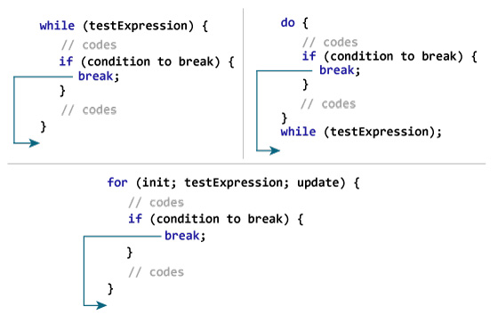
How break statement works?

Slide 4
Example 1: break statement
// Program to calculate the sum of maximum of 10 numbers
// If negative number is entered, loop terminates and sum is displayed
# include <stdio.h>
int main(){
int i;
double number, sum = 0.0;
for(i=1; i <= 10; ++i){
printf("Enter a n%d: ",i);
scanf("%lf",&number);
// If user enters negative number, loop is terminated
if(number < 0.0){
break;}
sum += number; // sum = sum + number;}
printf("Sum = %.2lf",sum);
return 0;
}

Slide 5
continue Statement
The continue statement skips statements after it inside the loop. Its syntax is:
continue;
The continue statement is almost always used with if...else statement.

Slide 6
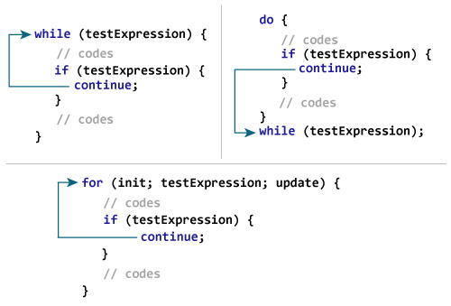
How continue statement works?

Slide 7
Example 2: continue statement
// Program to calculate sum of maximum of 10 numbers
// Negative numbers are skipped from calculation
# include <stdio.h>
int main(){
int i;
double number, sum = 0.0;
for(i=1; i <= 10; ++i){
printf("Enter a n%d: ",i);
scanf("%lf",&number);
if(number < 0.0){
continue;}
sum += number; // sum = sum + number;}
printf("Sum = %.2lf",sum);
return 0;
}

Slide 8
goto statement
The goto statement is used to alter the normal sequence of a C program.
Syntax:
goto label;
... .. ...
... .. ...
... .. ...
label:
statement;

Slide 9
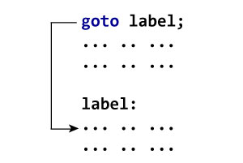
goto statement
The label is an identifier. When goto statement is encountered, control of the program jumps to label: and starts executing the code.

Slide 10
Example: goto Statement
// Program to calculate the sum and average of maximum of 5 numbers
// If user enters negative number, the sum and average of previously entered positive numbers are displayed
# include <stdio.h>
int main(){
const int maxInput = 5;
int i;
double number, average, sum=0.0;
for(i=1; i<=maxInput; ++i){
printf("%d. Enter a number: ", i);
scanf("%lf",&number);
// If user enters negative number, flow of program moves to label jump
if(number < 0.0)
goto jump;
sum += number; // sum = sum+number;
}
jump:
average=sum/(i-1);
printf("Sum = %.2f\n", sum);
printf("Average = %.2f", average);
return 0;
}

